Slide 1
13.3 Entanglement for Photon Pairs
We have seen
Photon-number entanglement
Energy-time entanglement
Here is a brief overview of schemes for creating
Polarization entanglement
Time-bin entanglement

Slide 2
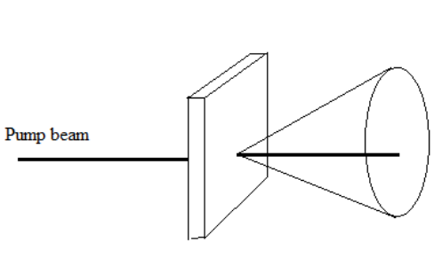




Polarization entanglement
Overlapping cones in non-collinear SPDC
Kwiat et al., PRL 75, 4337 (1999)
Type-I Phasematching:
Signal and idler emerge at opposite sides of two concentric cones.
Phasematching: ${\vec{k}}_{s}+{\vec{k}}_{i}={\vec{k}}_{p}$
$${\vec{k}}_{s}$$
$${\vec{k}}_{i}$$
$${\vec{k}}_{p}$$
The size of the cones is determined by the refractive indices at the given wavelengths.

Slide 3
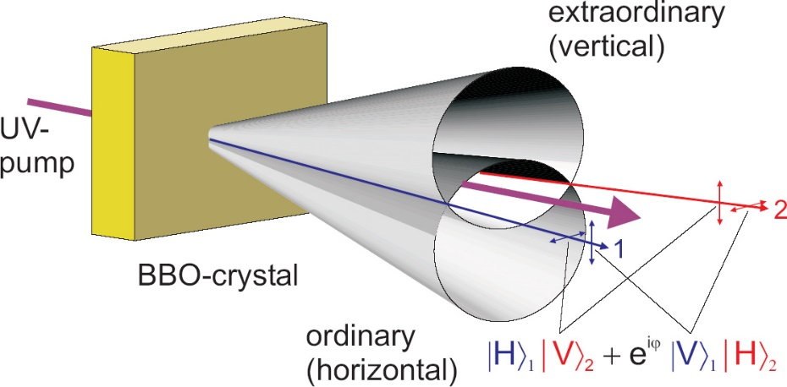
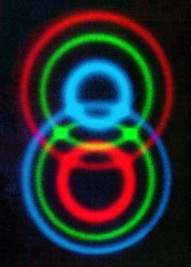




Polarization entanglement
Overlapping cones in non-collinear SPDC
Kwiat et al., PRL 75, 4337 (1999)
Phasematching: ${\vec{k}}_{s}+{\vec{k}}_{i}={\vec{k}}_{p}$
$${\vec{k}}_{s}$$
$${\vec{k}}_{i}$$
$${\vec{k}}_{p}$$
Type-II Phasematching:
For each wavelength, two cones are emitted, corresponding to the two possible polarizations.
For identical wavelengths of signal and idler photons, the intersection points of the cones correspond to polarization entanglement.
Blue: 681nm Green: 702nm
Red: 725nm

Slide 4
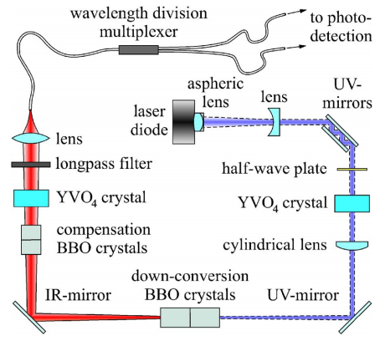
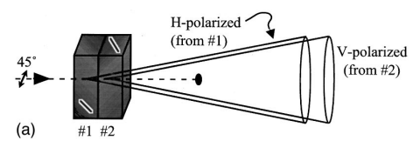
Polarization entanglement
Cascaded down-conversion crystal
For suitable arrangements, one cannot distinguish, whether the photon pair was created in the first or the second crystal.
Non-collinear phase-matching:
Crystals need to be thin compared to diameter of the pump laser.
Collinear phase-matching:
Temporal walk-off (GVD) needs to be compensated.
Kwiat et al., PRA 60, R773 (1999)
Trojek & Weinfurter, APL 92, 211103 (2008)

Slide 5
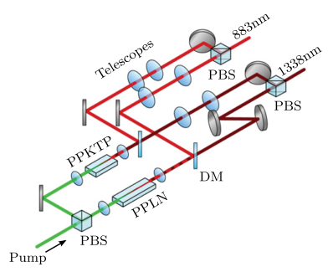
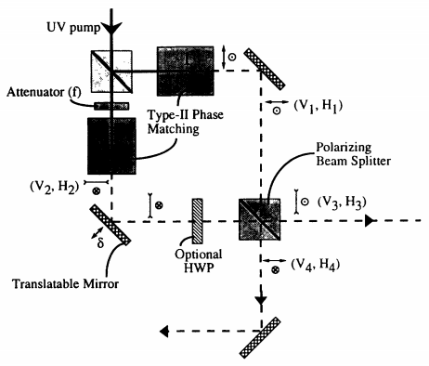
Polarization entanglement
Mach-Zehnder Interferometer
Pump is split coherently, such that also the output state is a coherent superposition of SPDC in both crystals.
Challenge: Phase stability.
Clausen et al.,
New J. Phys. 16, 093058 (2014)
Kwiat et al., PRA 49, 3209 (1994)

Slide 6
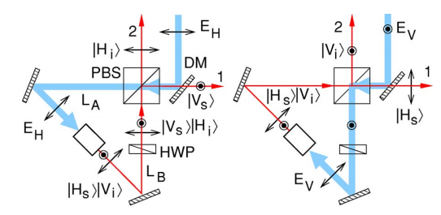
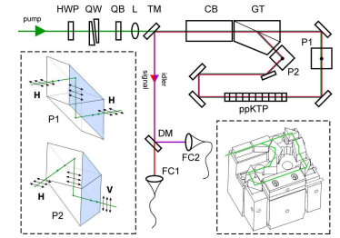
Polarization entanglement
Sagnac Interferometer
Since both photons traverse the same optics, this is inherently phase stable.
Kim et al., PRA 73, 012316 (2006)
Hentschel et al.,
Opt. Express 17, 23153 (2009)

Slide 7
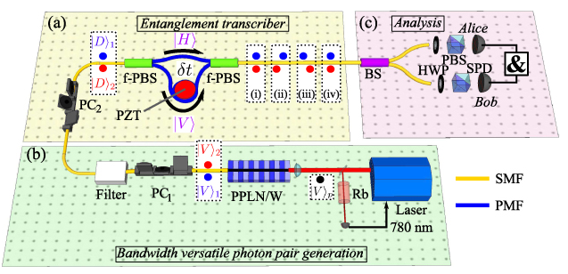
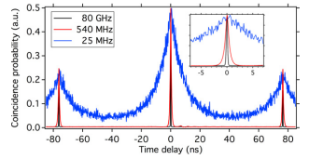
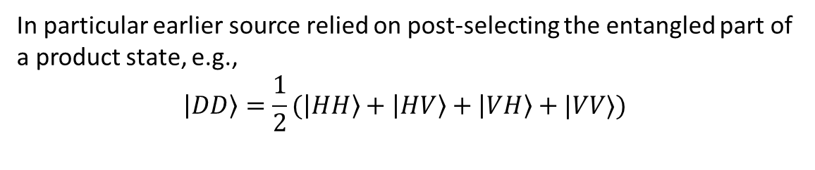
Polarization entanglement
Post-selected
In particular earlier source relied on post-selecting the entangled part of a product state, e.g.,
$$|DD〉=\frac{1}{2}(|HH〉+|HV〉+|VH〉+|VV〉)$$
Kaiser et al., Laser Phys. Lett. 10, 045202 (2013)

Slide 8
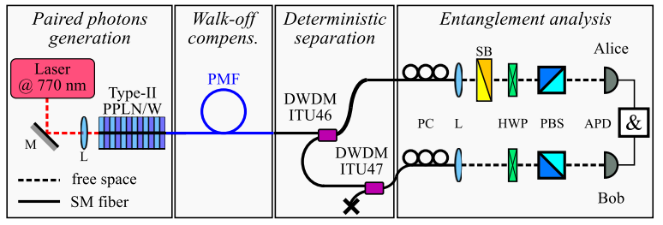
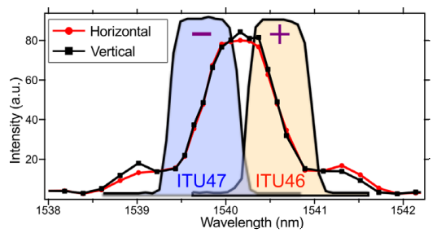
Polarization entanglement
Making use of spectral correlations
Using a narrow-band pump in degenerate type-II SPDC, polarization-entanglement can be achieved by clever spectral filtering.
Kaiser et al.,
NJP 14, 085015 (2012)

Slide 9
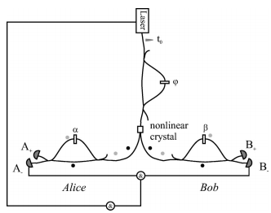
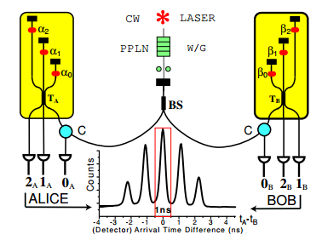
Time-bin entanglement
In pulsed SPDC, an imbalanced interferometer coherently splits the pump into two time-bins. Photon pairs are generated with entanglement between two temporal modes.
Contrary to polarization entanglement, time-bins can have higher dimension than 2.
Post-selected
Marcikic et al., PRA 66, 062308 (2002)
Thew et al.,
Quant Inf. Comp. 4, 93 (2004)

